Slide 1



Slide 2

Voice authentication system
Supervised by:
Dr. Shehzad Faisal
Group Members:
Bilal Jabbar(FA18-BSE-076)
Saad Zahid Qureshi (FA18-BSE-086)
Department of Computer Science
COMSATS University Islamabad, Attock Campus

Slide 3
Outline
Introduction
Problem statement
Objectives
Benefits
Methodology
Modern tools
Our System
References
_______________________________

Slide 4

Introduction
Automated voice authentication system by taking employee voice input via mic (frequency pitch intensity) that will train the model, and maintain a dataset of all the employees record that taken during the registration process through a web app.
System can get data of employee after the voice has been matched in order to start the employee services procedure.
GMM (Gaussian Mixture Model) will make this system automate for features extraction of employee’s voice, and generate a report in the form of a label data.
For the authentication, the employee has to record his/her voice to login to the system.
_______________________________

Slide 5
Problem statement
User faces security and time-consumption issues during authentication process because whole of the authentication process is manual to examine the user.
Speaker recognition is future based methodology that is commonly used nowadays, so transformation from traditional authentication is very convenient.
Normal authentication tools are highly expensive than a simple mic. Like facial recognition cameras fingerprint reader etc.
_______________________________

Slide 6
What is voice?
The sound or sounds uttered through the mouth of living creatures, especially of human beings in speaking.
The mixture of vocabulary, tone, point of view, and syntax that makes phrases, sentences, and paragraphs flow in a particular manner
_______________________________

Slide 7
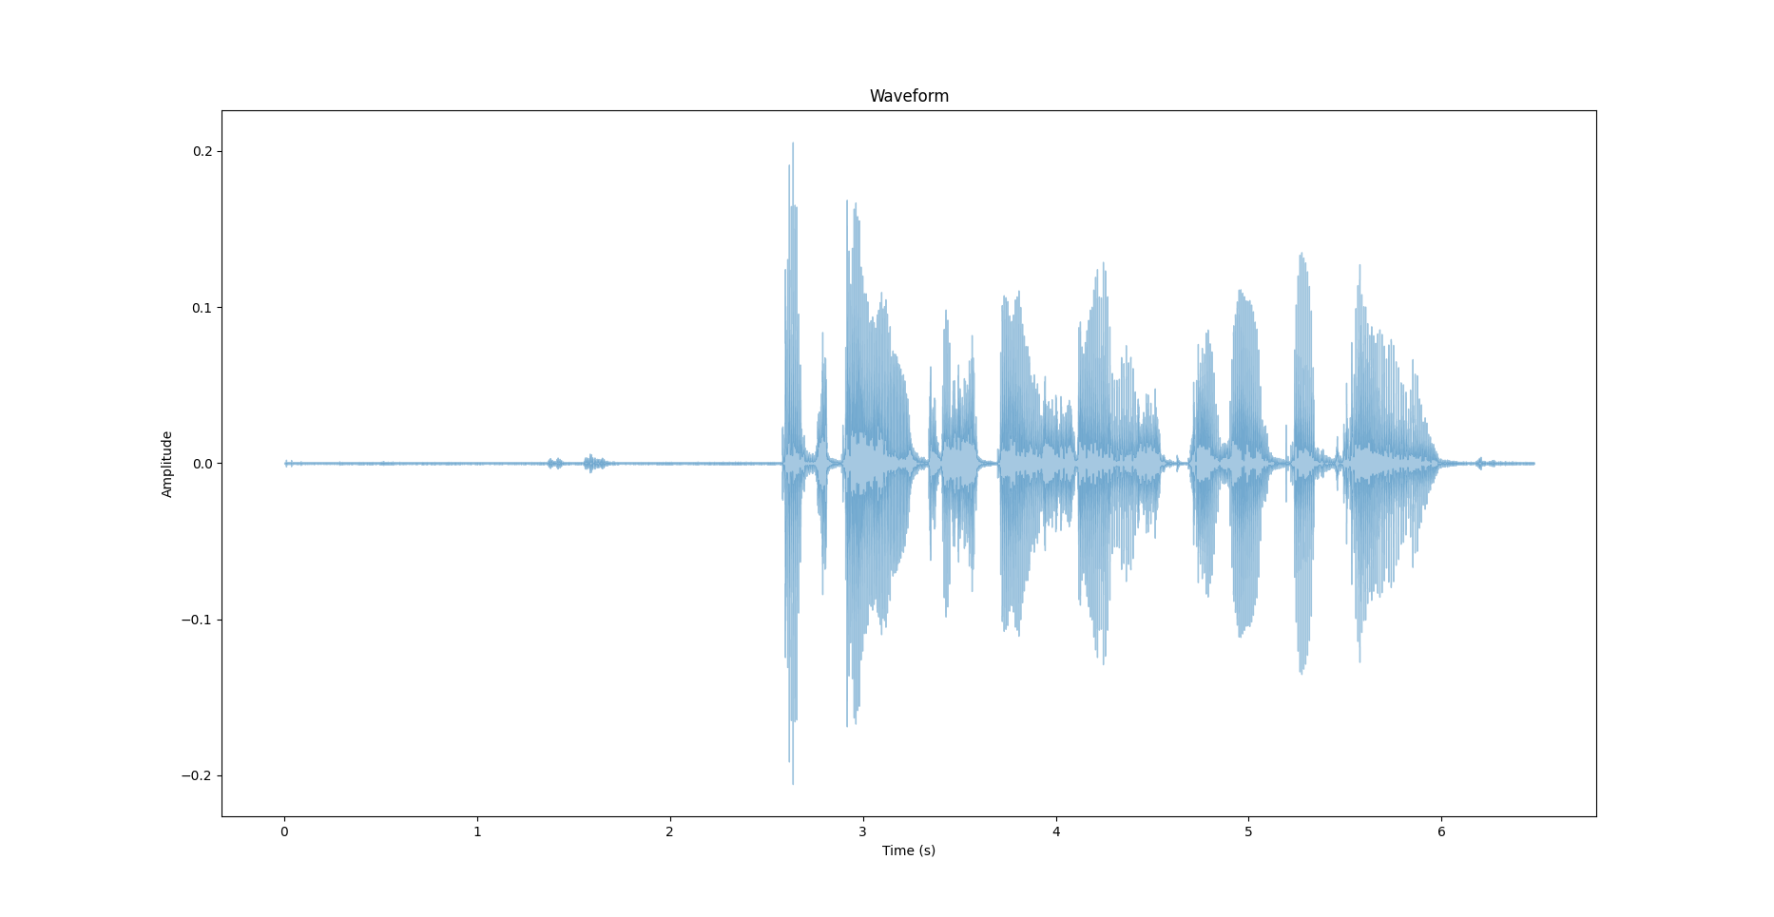
Voice in a waveform
_______________________________

Slide 8
Authentication
Used to identify,
To validate,
And to verify.
_______________________________

Slide 9

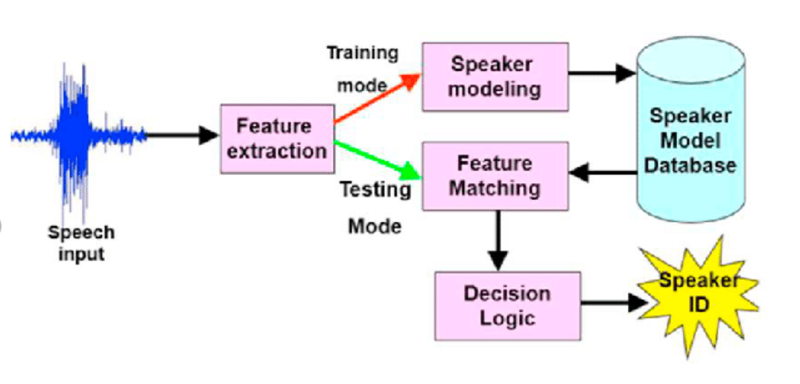

Block Diagram
users
website
_______________________________
9

Slide 10
Gaussian Mixture Model
Gaussian mixture models (GMM) are a probabilistic concept used to model real-world data sets
Type of machine learning algorithm, used to classify data into different categories based on the probability distribution.
_______________________________
10

Slide 11
Feature Extraction
Features extraction in voice authentication is the computation of a sequence of feature vectors which provides a compact representation of the given speech signal.
The distinct features of the voice used to differentiate between different speakers.
For this system, we are using MFCC and Delta-MFCC.
_______________________________
11

Slide 12
MFCC and Delta-MFCC
MFCC stands Mel Frequency Cepstral Coefficients. It is nearly close to human voice and hence it is best for speaker recognition.
It is robust due to its accurate estimate of the speech parameters and efficient computation -nal model of speech
By taking first derivative of MFCC features we can extract the Delta MFCC features.
_______________________________
12

Slide 13
Objectives
To provide a secure and rapid services through automated voice authentication system for customer.
Automated features extraction to synchronize with the system.
System security performance is quick so it’s beneficial for customer data.
Enhance security and reliability of the system to restrict unauthored access.
_______________________________

Slide 14
Benefits
This system provide more secure and reliable authentication system for customer services using voice authentication.
Customer’s profile generated and system train the model over customer’s voice automatedly.
The main purpose is less time-consumption for customer services and this issue resolve by this system.
_______________________________

Slide 15
Development Requirements
Software Requirements dependence:
IDE: PyCharm (version 2022.1.2), Vscode (version 1.68)
Programming language: Python, HTML, CSS, JavaScript
Database: PostgreSQL
Tools: Pytorch, deep learning algorithms
Hardware Requirements dependence:
PC : Active internet
Mic

Slide 16
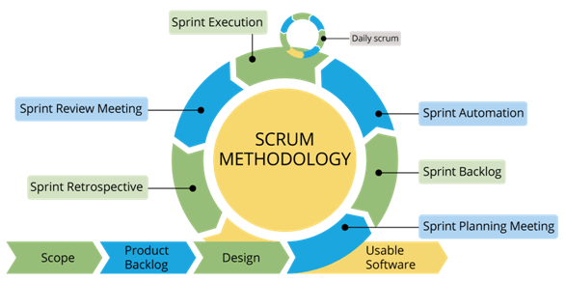
Rationale behind Selected Methodology
Selection of this methodology as we are developing in increment forms so if change require after result showing to supervisor.
Can easily get break point so we able to change as supervisor tells us plus to take a look on the results of customer voice as they should be accurate that system will get.
_______________________________

Slide 17
Modern tools
Tools | Version | Rationale
PyCharm | 2022.1.2 | IDE
PostgreSQL | 8.0.23 | DBMS
vscode | 1.68 | frontend Work
MS Word | 2019 | Documentation
MS Power Point | 2019 | Presentation
Adobe XD | 2.1.32 | Prototyping
_______________________________

Slide 18
Demo

Slide 19
References
https://papers.ssrn.com/sol3/papers.cfm?abstract_id=3667519
https://realpython.com/python-speech-recognition/#how-speech-recognition-works-an-overview
M. Anusuya and S. Katti, "Front end analysis of speech recognition: a review,“ International Journal of Speech Technology, vol. 14, pp. 99-145, 2011.
https://www.g2.com/categories/biometric-authentication
_______________________________

